Slide 1

Notes:
A serene, travel-inspired cover page that embodies the spirit of exploration and freedom. Weekend Wings invites users to embark on journeys that redefine their weekends — a gateway to relaxation, adventure, and unforgettable memories.

Slide 2
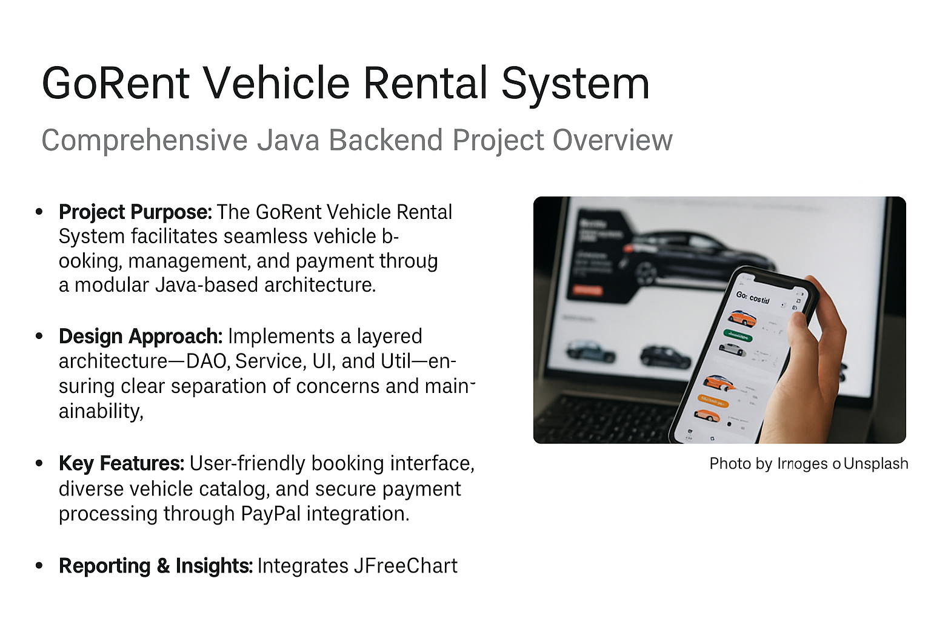


Slide 3
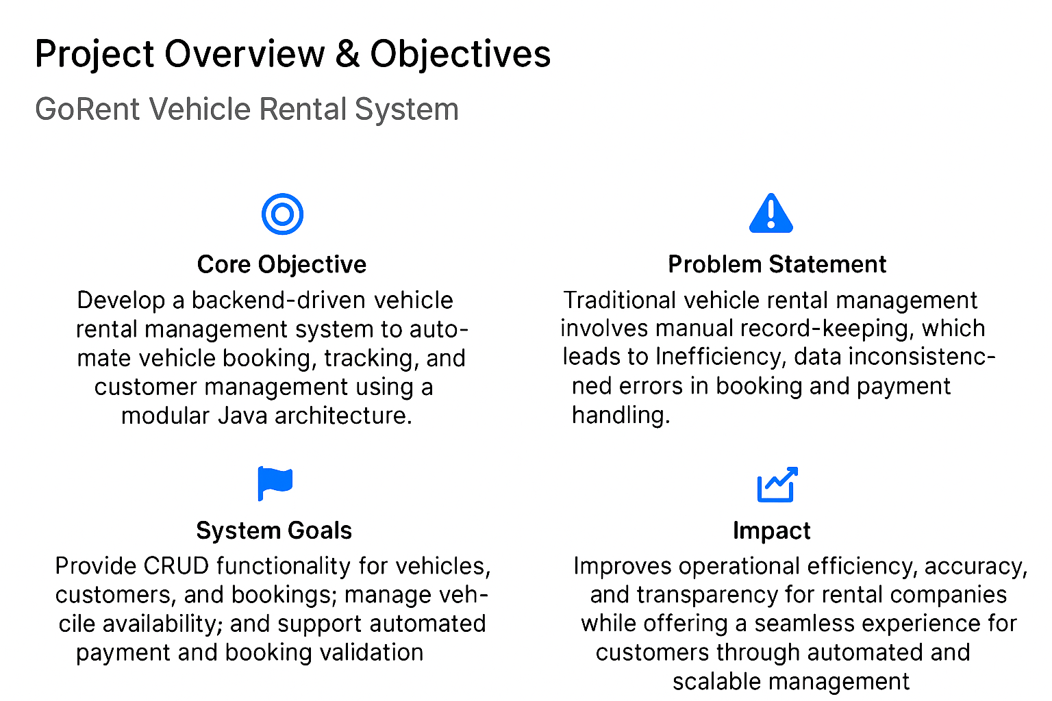

Slide 4
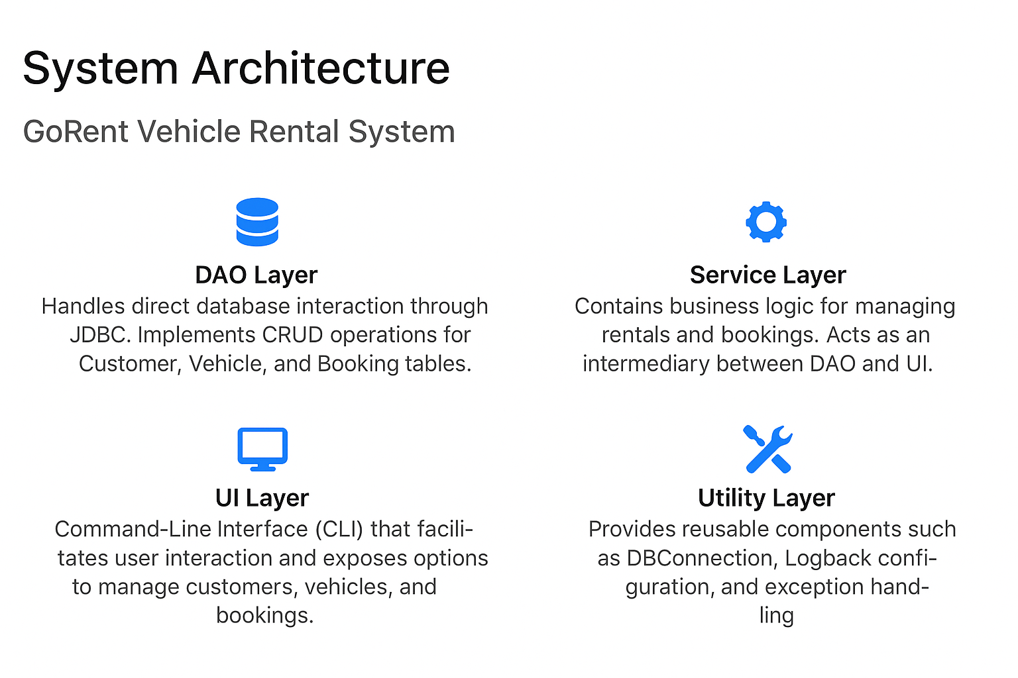
Notes:
This architecture embodies clean separation of concerns, a core principle of maintainable software engineering.\n\nThe DAO layer is responsible for communicating with MySQL using JDBC, encapsulating all SQL logic. Above it, the Service layer enforces business rules — from net pay computation to dynamic salary components.\n\nThe UI is kept lightweight via a text-based CLI, offering clarity and testability. Finally, utilities like DBConnection and Logback configuration make the system extensible and production-ready.

Slide 5
Technology Stack
Tools and Frameworks Powering Weekend Wings
Java (Core + JDBC): Implements object-oriented principles and modular backend logic for rental operations, enabling smooth database interaction through JDBC.
MySQL Database: Stores customer, vehicle, and booking data securely, with DAO classes managing CRUD operations and relationships efficiently.
Maven Project: Handles dependencies, project lifecycle, and build automation, ensuring consistent execution across multiple environments.
Log back & JUnit: Log back is used for structured logging and debugging during runtime, while JUnit supports unit testing for DAO and Service layers to ensure code reliability.
Exception Handling: Implements robust error-handling mechanisms to manage invalid inputs, failed bookings, and database exceptions gracefully.
Notes:
The technical foundation of Weekend Wings is designed to mirror real-world enterprise systems. The combination of Java and MySQL provides reliability, while Maven keeps the project portable and easy to maintain.\n\nLogging and testing are integral parts of professional software. Logback allows for configurable logging, helping track runtime activities. Meanwhile, JUnit supports systematic verification of business logic.\n\nFinally, JFreeChart adds polish to the project with visual insights — bridging backend analytics with managerial usability.

Slide 6
Core Features
Customer Management: Add, view, update, delete, and search customer records to efficiently handle user registrations and maintain accurate customer information.
Vehicle Management: Register new vehicles, update existing vehicle details, and monitor availability status for streamlined fleet management.
Booking Operations: Enable customers to book, view, or cancel vehicle rentals with automatic validation of vehicle availability and booking dates.
Payment and Billing: Compute total rental cost dynamically based on duration, vehicle type, and additional charges using modular Java service logic.
User-Friendly Navigation: A simple, intuitive CLI menu guides users through all operations—customer handling, vehicle registration, and booking management—with clear prompts and smooth workflow.
Notes:
The command-line interface (CLI) acts as the primary interaction layer of the Weekend Wings Payroll System. It exposes ten intuitive options to handle every aspect of payroll — from employee onboarding to salary computation.\n\nUsers can easily navigate between listing employees, managing salary components, and updating base pay. The modular menu ensures that every option is linked to a specific function implemented in the Service and DAO layers.\n\nThis approach not only keeps the system lightweight and platform-independent but also makes it ideal for showcasing backend design principles during viva or demonstrations.

Slide 7
Advanced Rental Engine with Component-Based Design
Dynamic Pricing: Each rental’s total cost is computed based on vehicle type, rental duration, and additional components such as fuel charges, driver fees, or late-return penalties.
Formula-Based Calculation: Implements formulas like Total Cost = (Daily Rate × Days) + Additional Charges – Discounts through Java service logic, enabling flexible and accurate billing computation.
Data Integrity: All booking and billing operations are transactional, handled through the DAO layer to ensure consistency and synchronization with the MySQL database.
Reusable Services: The computation module is designed as a reusable service, supporting scalability and easy integration with future features such as online payments or loyalty discounts.
Notes:
At the heart of the Weekend Wings Payroll System lies a dynamic computation engine. Instead of hardcoded salary formulas, it uses modular salary components that can be added or removed for each employee.\n\nThis design gives flexibility for organizations to define custom allowances, deductions, and incentives. The system calculates the final net pay automatically using the Service layer, which retrieves and processes data from the DAO.\n\nThe result is a flexible, scalable payroll mechanism that adapts to any compensation model — all within a few lines of Java logic.

Slide 8
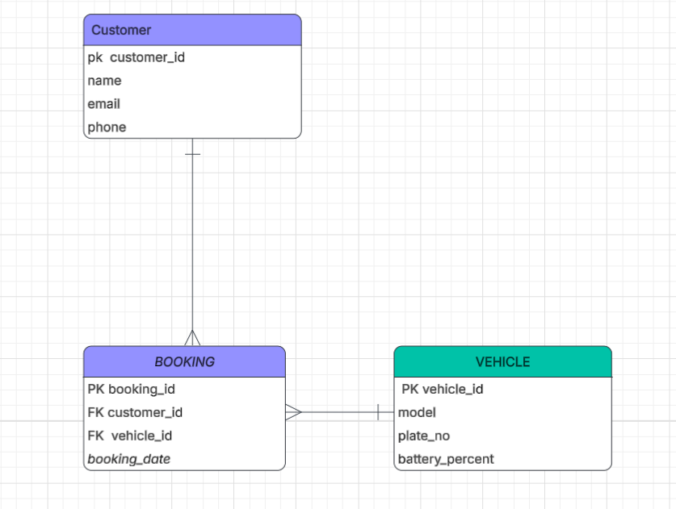
ER DIAGRAM
.
Notes:
Testing and logging are foundational to software robustness. In Weekend Wings, JUnit ensures that every method in the DAO and Service layers works as expected through isolated and automated tests.\n\nLogback complements this by offering a detailed record of all runtime activities — from database connections to payroll calculations. These logs are invaluable during debugging, helping identify and fix issues efficiently.\n\nThis disciplined approach to testing and logging mirrors industry-grade software practices and gives confidence in the stability and correctness of the system.

Slide 9
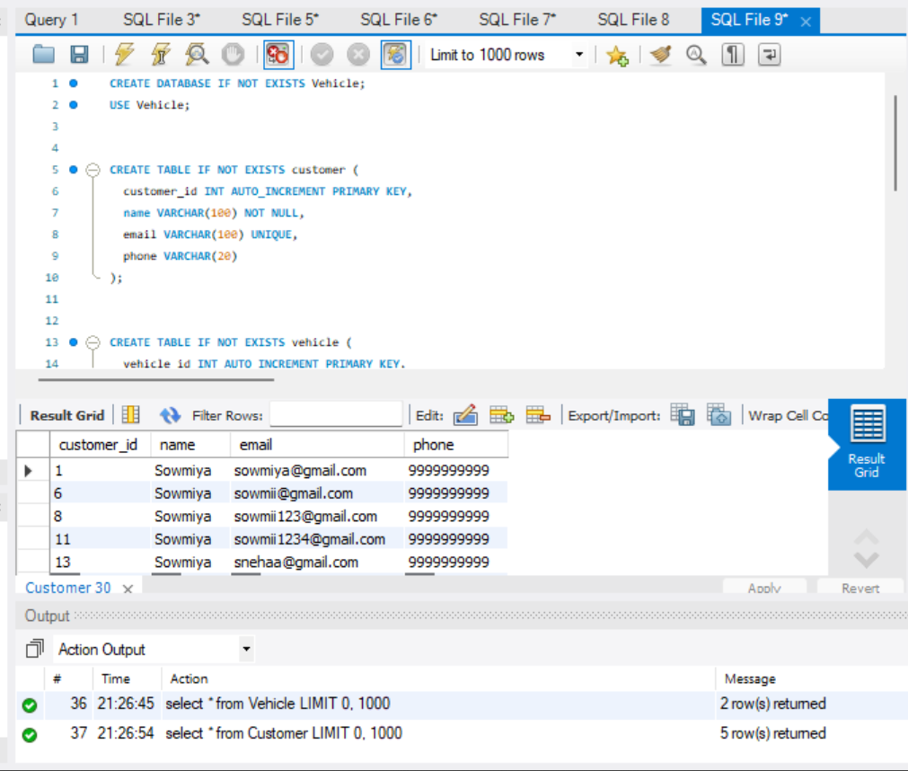
DATABASE
Photo by Christina @ wocintechchat.com on Unsplash
Notes:
The MySQL schema design follows a normalized structure with clear relationships between employees and their salary components. The Employee table serves as the central entity, while SalaryComponent acts as a dependent table containing all variable salary elements.\n\nBy using foreign keys and relational integrity, the design guarantees that every component belongs to a valid employee. This ensures consistent payroll calculations and simplifies CRUD operations in the DAO layer.\n\nThis approach not only reduces redundancy but also provides scalability, making it easy to integrate additional features like department-level analytics or historical payroll tracking.

Slide 10
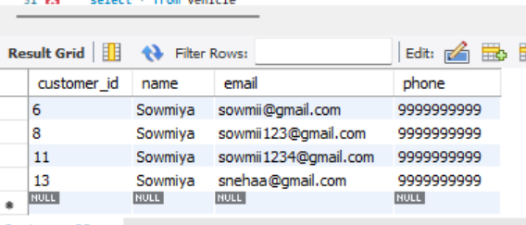
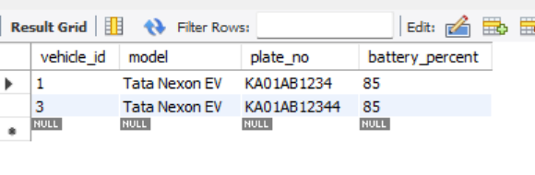
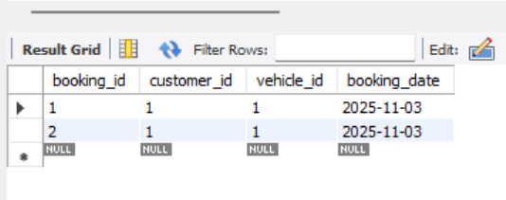
RESULT
Notes:
To conclude, the Weekend Wings Payroll Management System represents a complete, production-grade backend application built using Java’s best practices.\n\nIt showcases a clear architectural separation, rigorous testing, and real-time data reporting. Every module — from employee CRUD operations to salary computation — reflects professional software design.\n\nFor viva and academic submission, the README and PROJECT_SUMMARY.txt provide a comprehensive overview of setup, features, and insights gained during development. This project stands as a showcase of both coding proficiency and system design thinking.

Slide 11
Thank You
Fly High. Relax. Repeat.
Photo by Stephanie Cantu on Unsplash
Notes:
A closing note that captures the essence of Weekend Wings — freedom, relaxation, and adventure. This final slide expresses gratitude and leaves the audience with the uplifting imagery of flight and possibility.

